Slide 1
STRATEGIC WORKFORCE PLANNING
.

Slide 2
Strategic Workforce Planning
First component of HRM strategy
All other functional HR activities are derived from & flow out of HRP process
Basis in considerations of future HR requirements in light of present HR capabilities & capacities
Proactive in anticipating & preparing flexible responses to changing HR requirements
Both internal & external focus

Slide 3
Strategic Workforce Planning
Goes beyond simple hiring & firing
Involves planning for deployment of human capital in line with organization &/or business unit strategy
May involve:
Reassignment
Training & development
Outsourcing
Using temporary help or outside contractors
Needs as much flexibility as possible

Slide 4
Key Objectives
Prevent overstaffing & understaffing
Ensure organization has right employees with right skills in right places at right times
Ensure organization is responsive to changes in environment
Provide direction & coherence to all HR activities & systems
Unite perspectives of line & staff managers

Slide 5
Types of Planning
Aggregate Planning
Anticipating needs for groups of employees in specific, usually lower level jobs & general skills employees will need to ensure sustained high performance
Succession Planning
Focuses on ensuring key critical management positions in organization remain filled with individuals who provide best fit

Slide 6
Aggregate Planning
Forecasting demand
Considers firm’s strategic plan’s effects on increases or decreases in demand for products or services
Assumptions on which forecast is predicated should be written down & revisited when conditions change
Unit forecasting (bottom-up planning) involves “point of contact” estimation of future demand for employees
Top-down forecasting involves senior managers allocating a fixed payroll budget across organizational hierarchy
Demand for employee skills requirements must also be considered

Slide 7
Aggregate Planning
Forecasting supply
The level and quantities of abilities, skills & experiences can be determined using Skills Inventory.
Annually updated human resource information system (HRIS) is dynamic source of HR information
Markov analysis can be used to create transition probability matrix that predicts mobility of employees within organization

Slide 8
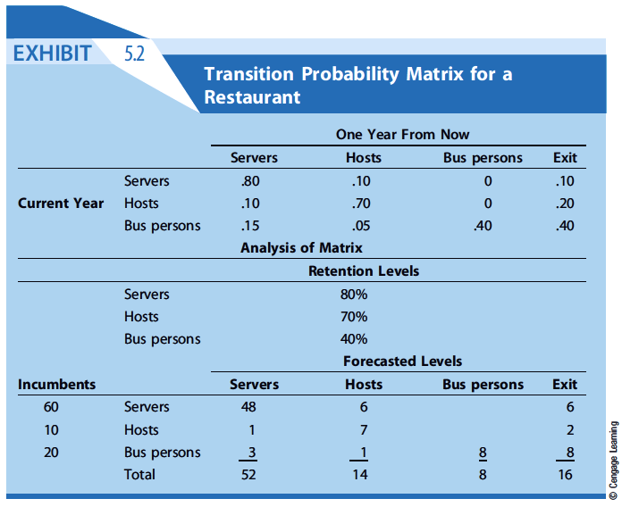

Slide 9
Strategies for Managing Shortages
Recruit new permanent employees
Offer incentives to postpone retirement
Rehire retirees part-time
Attempt to reduce turnover
Work current staff overtime
Subcontract work out
Hire temporary employees
Redesign job processes so fewer employees are needed

Slide 10
Strategies for Managing Surpluses
Hiring freezes
Do not replace those who leave
Offer early retirement incentives
Reduce work hours
Voluntary severance leaves of absence
Across-the-board pay cuts
Layoffs
Reduce outsourced work
Employee training
Switch to variable pay plan
Expand operations

Slide 11
Succession Planning
Involves identifying key management positions the organization cannot afford to have vacant
Purposes of succession planning
Facilitates transition when employee leaves
Identifies development needs of high-potential employees & assists in career planning
Many organizations fail to implement succession planning effectively
Qualified successors may seek external career advancement opportunities if succession is not forthcoming

Slide 12
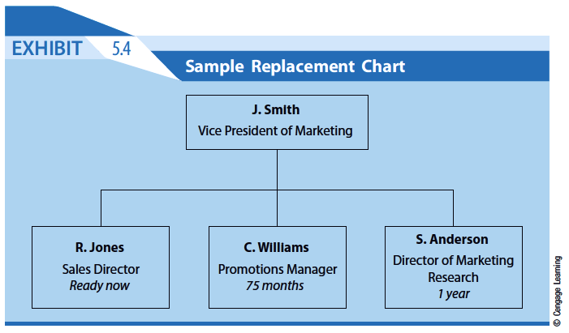

Slide 13
Guidelines for Effective Succession Planning
• Tie into organization’s strategy (and modified accordingly)
• Monitor the progress and measure outcomes of succession planning initiatives
• Ensure that all HR functions that impact the succession plan are iterated and working in tandem
• Ensure centralized coordination of succession planning
• Engage and involve managers throughout the organization

Slide 14
